Slide 1
SPORTS EVENT MANAGEMENT SYSTEM

Slide 2
ABSTRACT
The project brings the entire manual process of sports event management online which is built using JAVA as a front end and SQL Server as a backend. The main purpose of this project is to simplify the process of handling each sports event by providing a web interface for admin and teacher. The admin part consists of multiple modules to initiate with the sports event by adding the type of sport (indoor or outdoor), adding student who are interested in a particular sports activity, adding teachers who will conduct the particular sports activity which is allotted by the admin itself and lastly, viewing the results of sports event held in college. The teacher part has come up with handling all the sports related activity assigned by the admin. Teacher performs various task such as taking the attendance of the students who are registered for a particular sport event, viewing the list of students to mark the winner of each round, generating the results based on multiple rounds won by the student and also can view the 1st, 2nd and 3rd standings of student’s name for the particular sport event.

Slide 3
HARDWARE SPECFICATION
Processor : P 4 700 GHz.
RAM : 4 GB RAM
Hard Disk Drive : 180 GB

Slide 4
SOFTWARE SPECIFICATION
Operating System : Windows 7/8/10
Front End : JAVA
Back End : SQL

Slide 5
EXISTING SYSTEM
In the existing Sports Event Management system, students are not able to get proper information about the games conducted in various colleges. The student needs to spend the time to get the information about the game. The student should attend the venue to get registered for the game which takes a lot of time.
DISADVANTAGES
No aware for outside tournaments
Can’t managing the team strength
Can’t generating the report for the tournament

Slide 6
PROPOSED SYSTEM
In the proposed Sports Event Management system student can get all the information of various games and the venue. The student can get registered from anywhere and at any time. By using this system student can save a lot of time and effort. The student can easily get the information from anywhere.
ADVANTAGES
Can track the team details
Find the registration team details
All the tournament details view in the single page

Slide 7
Modules
Player Registration
This user registration will help to register the user, who interested to join this tournament. This will store into the user table, when need to open the login this will help to validate username and password.
Team Registration
After the user login manually create the team, there is an n number peoples can be added in the team, it may differ based on the sports.

Slide 8
Tournament Booking Events
When user need to join the tournament, should before booking an event is an mandatory option to fill. Here the admin can store some condition to promote the changes as an no of team can be participate.
Event Registration
Admin will focus the create the event name and details as well, once the registration has been completed, it will shows in the user screen. User easily figure out and follow the tournament details.
Manage user details
Admin can see the user detail in his portal, the registered user can visible into the admin screen, the collect the user information and try to reach them.

Slide 9

DFD – LEVEL - 0

Slide 10
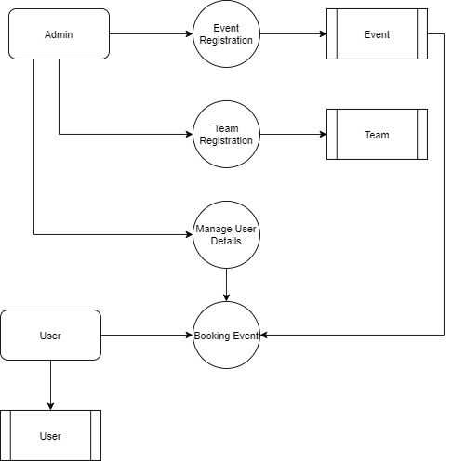
DFD – LEVEL -1

Slide 11
TABLE NAME: ADMIN
FIELD | DATA TYPE | SIZE | CONSTRAINT
Admin id | Int | 10 | Primary key
Username | Varchar | 20 | Not null
password | Varchar | 20 | Not null

Slide 12
TABLE NAME: EVENT
FIELD | DATA TYPE | SIZE | CONSTRAINT
Event id | Int | 10 | Primary key
Event name | Varchar | 20 | Not null
Event category | Varchar | 20 | Not null
Amount | Int | 10 | Not null
Total teams | Int | 10 | Not null
Location | Varchar | 20 | Not null
Contact person | Varchar | 20 | Not null
Mobile number | Int | 10 | Not null

Slide 13
TABLE NAME: USER
FIELD | DATA TYPE | SIZE | CONSTRAINT
User id | Int | 10 | Primary key
Username | Varchar | 20 | Not null
password | Varchar | 20 | Not null
Mobile number | Int | 10 | Not null

Slide 14
TABLE NAME: TEAM
FIELD | DATA TYPE | SIZE | CONSTRAINT
Team id | Int | 10 | Primary key
Team name | Varchar | 20 | Not null
Total team members | Int | 10 | Not null
Captain name | Varchar | 20 | Not null
Mobile number 1 | Int | 10 | Not null
Mobile number 2 | Int | 10 | Not null
Full address | Varchar | 30 | Not null

Slide 15
TABLE NAME: BOOKING
FIELD | DATA TYPE | SIZE | CONSTRAINT
Booking id | Int | 10 | Primary key
Event id | Int | 10 | Foreign key
Team id | Int | 10 | Foreign key
Booking status | Varchar | 15 | Not null

Slide 16
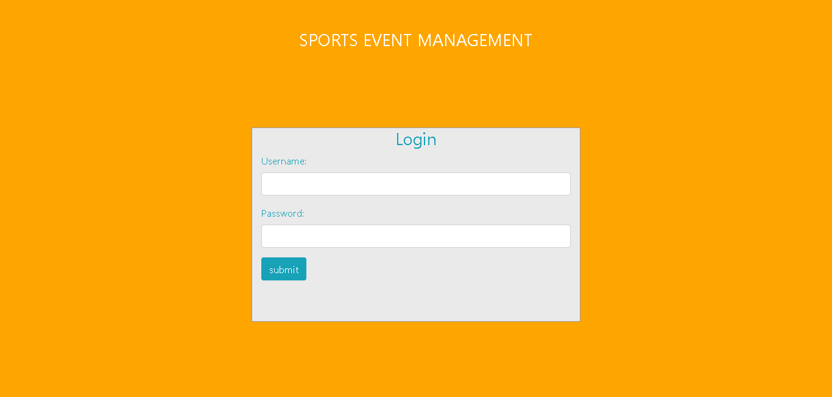

Slide 17
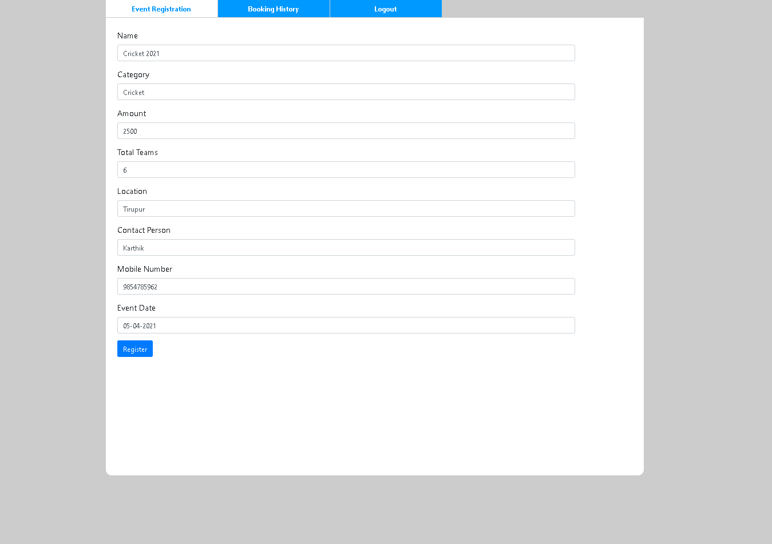

Slide 18
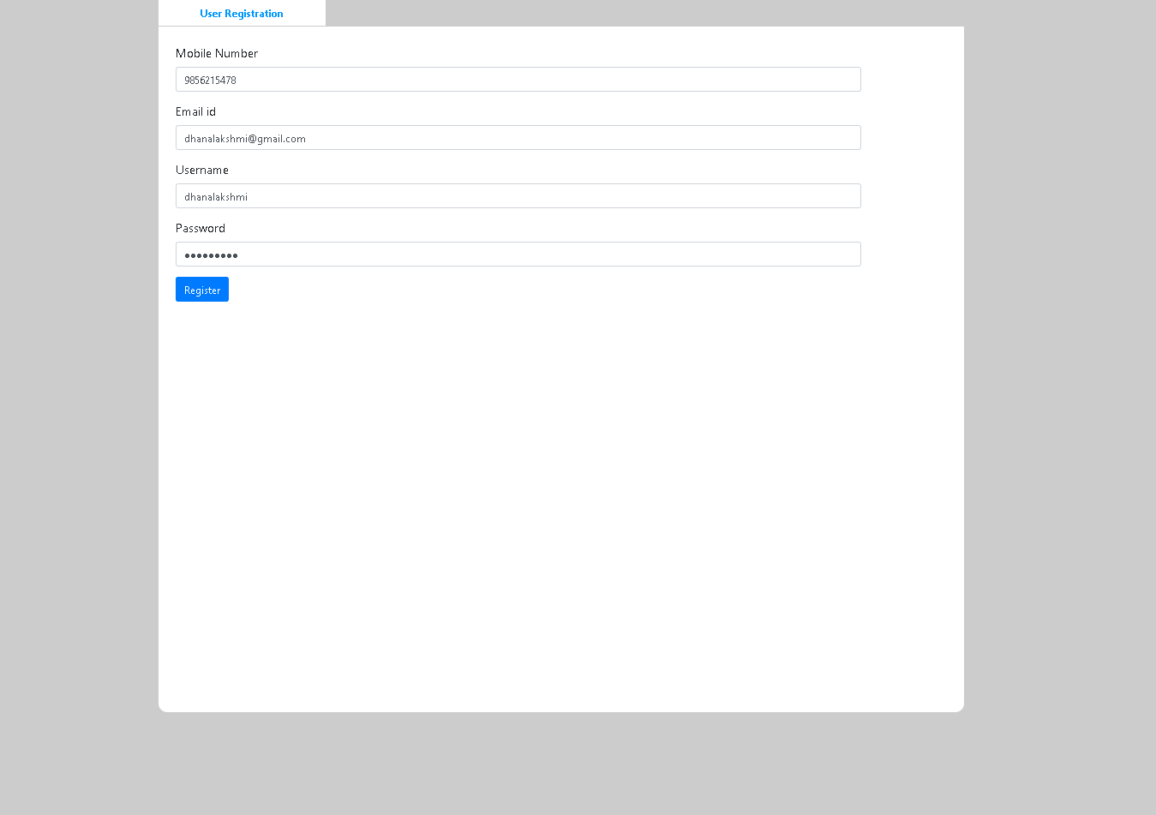

Slide 19
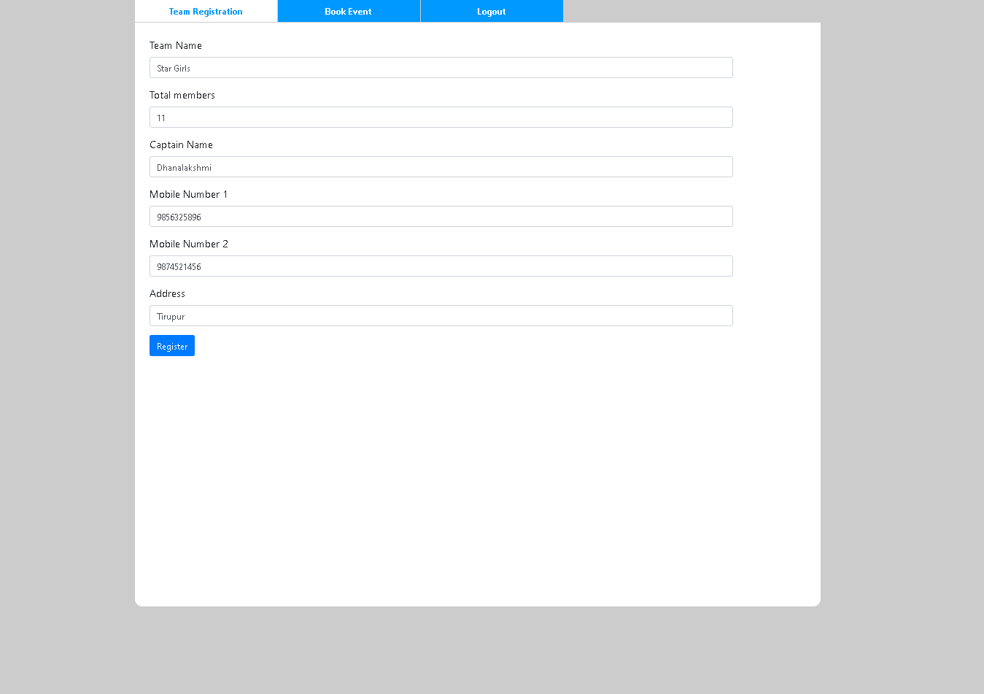

Slide 20
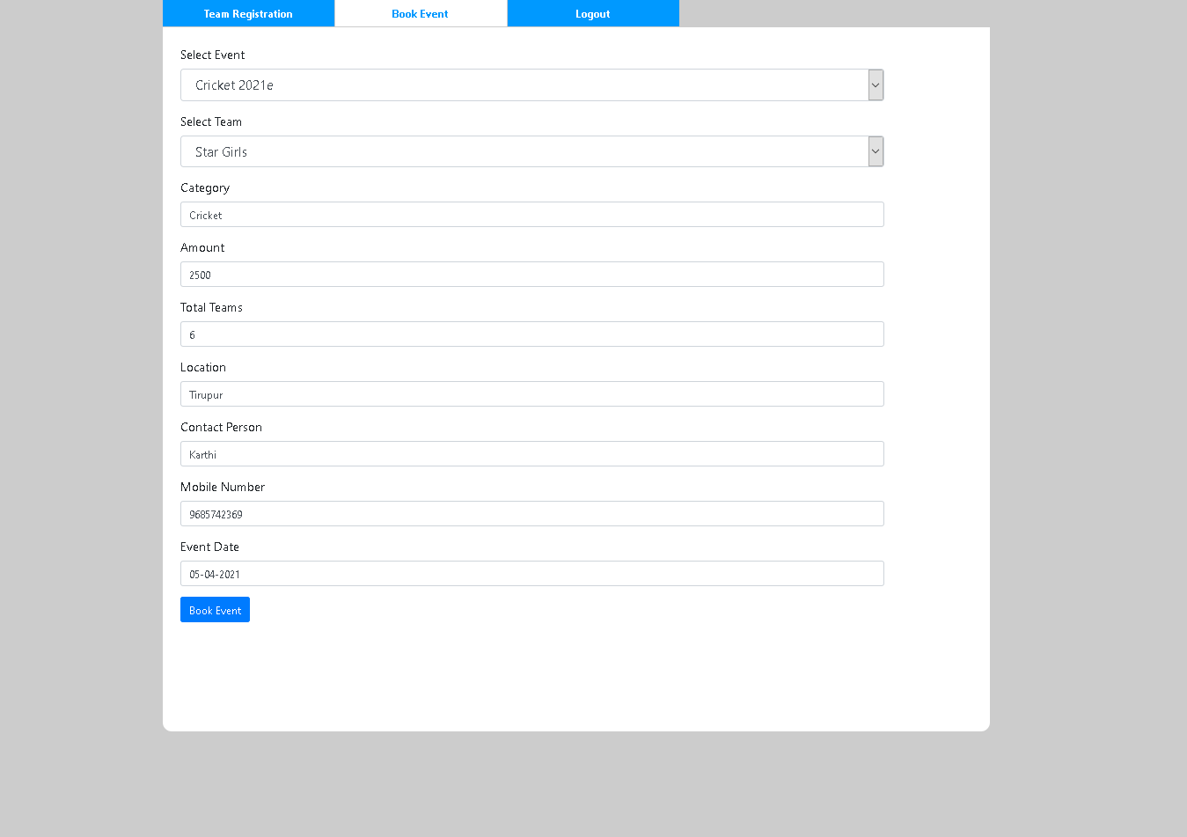

Slide 21
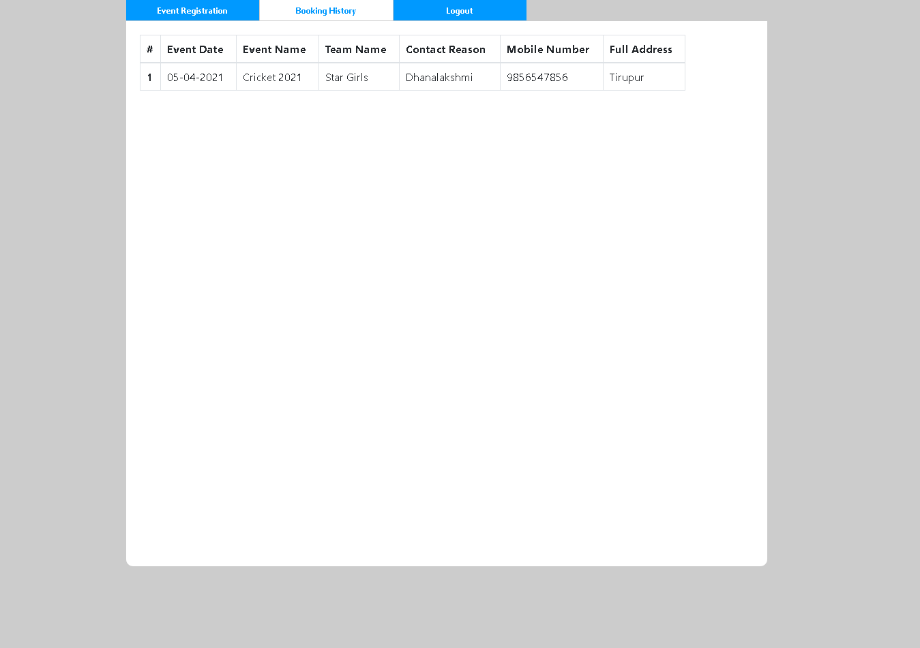

Slide 22
Thank You

